Slide 1

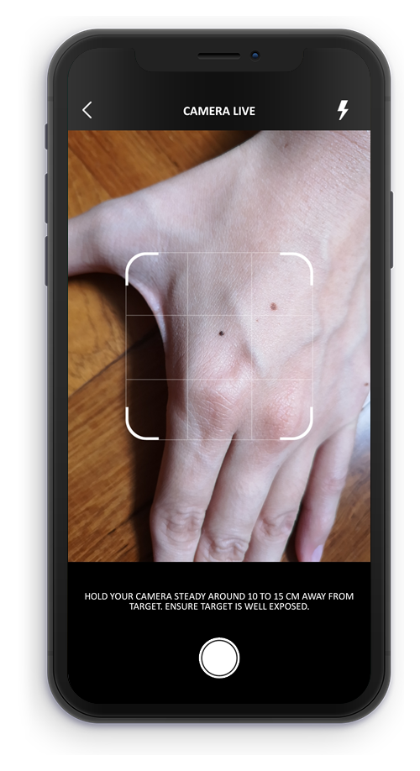
SKIN DISEASE DETECTION

Slide 2
Overview
Develop an AI-powered system that uses machine learning to detect skin diseases from images provided by users. The system will analyze the images, provide a description of the potential disease, offer recommendations for nearby dermatologists, and suggest if the disease requires isolation or special care measures.
ML Use Cases
Skin Disease Detection
Skin Condition Progress Tracking ⇽ Current Work
Isolation/Preventive Measures

Slide 3
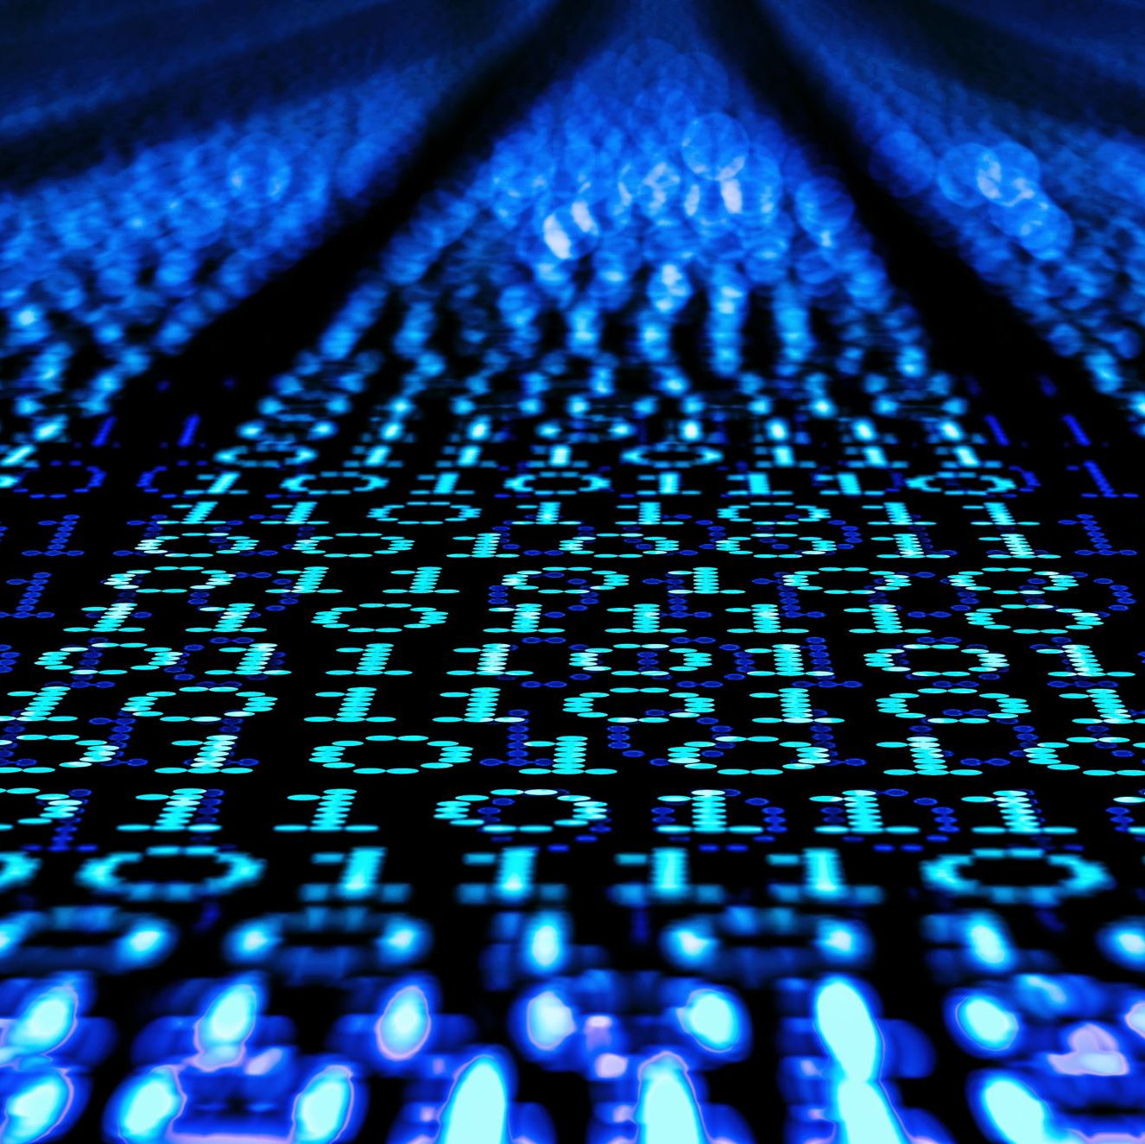
Dataset
Combination dataset of ISIC HAM10000 & DermNet Free dataset
The International Skin Imaging Collaboration (ISIC) is an academia and industry partnership designed to use digital skin imaging to help reduce skin cancer mortality.
HTTPS://WWW.KAGGLE.COM/DATASETS/KMADER/SKIN-CANCER-MNIST-HAM10000
DermNet - The world’s leading free dermatology resource.
HTTPS://DERMNETNZ.ORG/IMAGE-LIBRARY

Slide 4
Ensemble Model
InceptionResNetV2
1. Combines the strengths of the Inception architecture and residual connections, allowing it to capture both spatial hierarchies and skip connections that help in gradient flow, which is crucial for deep networks.
2. It is known for its deep and complex architecture, which is excellent at capturing intricate patterns and details in high-resolution images, making it suitable for identifying subtle features in skin lesions.
DensNet201
1. Uses dense connections, where each layer is connected to every other layer in a feed-forward fashion. This architecture helps in better feature reuse and mitigates the vanishing gradient problem, making it effective in capturing fine details in images.
2. It excels at feature propagation and extraction due to its densely connected layers, which is particularly beneficial for detecting fine-grained details and textures in skin images.

Slide 5
Ensemble Model
InceptionV3
1. Follows the Inception architecture, which divides the input into multiple paths and processes them with different filter sizes, enabling the model to learn spatial hierarchies and extract features at multiple scales.
2. Its ability to analyze images at multiple scales and resolutions makes it effective in identifying both small lesions and larger disease patterns.
What is Transfer Learning?
These models are pre-trained on large datasets like ImageNet, which provides a good starting point, as they have already learned to extract general features from images. When fine-tuned to a specific dataset like skin disease images, they can adapt these features to detect and classify various skin conditions more effectively.

Slide 6
Overview
Develop an AI-powered system that uses machine learning to detect skin diseases from images provided by users. The system will analyze the images, provide a description of the potential disease, offer recommendations for nearby dermatologists, and suggest if the disease requires isolation or special care measures.
ML Use Cases
Skin Disease Detection ⇽ Further Improvements
Skin Condition Progress Tracking ⇽ Current Work
Isolation/Preventive Measures

Slide 7
Suggested Work for Use Case 1:
Since validation results and test data had low accuracy, an additional neural network layer was suggested.
VGG16, known for its deep and straightforward structure, excels at capturing detailed hierarchical patterns in images, making it effective for feature extraction in skin disease detection.
Usually when used in an ensemble model, VGG16 enhances prediction accuracy and robustness, enabling reliable identification of subtle features in skin lesions.
Adding VGG16 to our final model layer with ‘Imagenet’ initial weights.

Slide 8
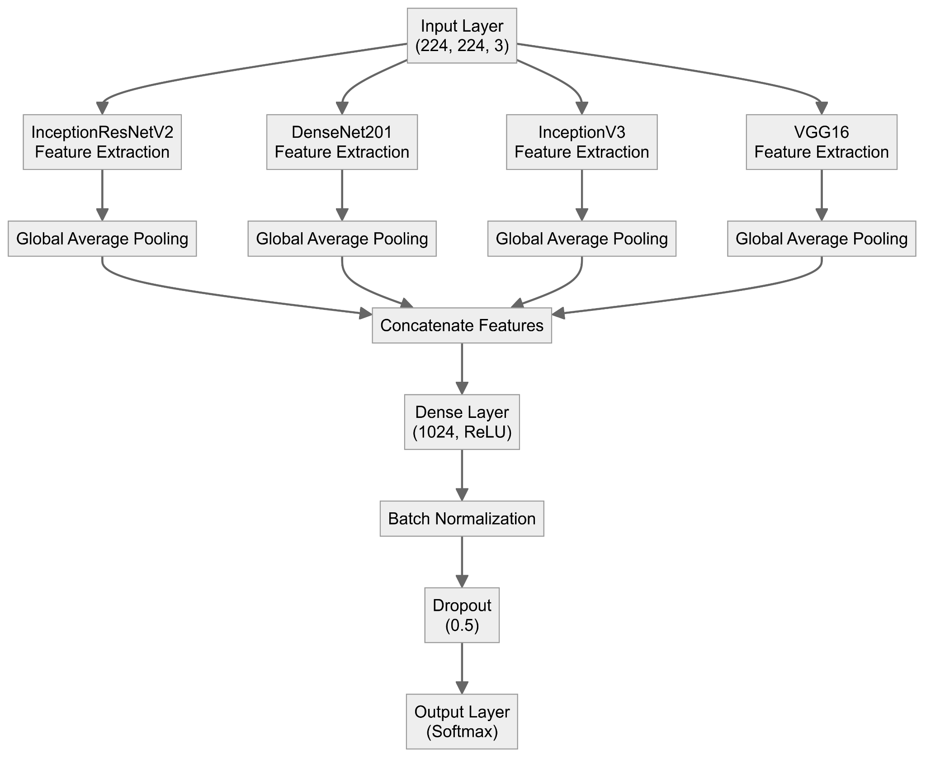

Slide 9
Performance Comparison
 | Without VGG16 | With VGG16
Training accuracy (15 epochs) | 95.83% | 95.13%
Validation Set
Loss | 16.499 | 16.682
Accuracy | 35.24% | 35.29%
Precision | 37.66% | 37.34%
Recall | 34.90% | 34.96%
Further Improvement
Use SMOTE to balance minority classes to have a balanced dataset and re-verify performance.

Slide 10
REST API
1. Name: Model Testing
2. Description: Provide test input image to the trained model to get disease name.
3. HTTP Command: POST
4. Signature: https://skin-det.com/detect/api=Skin-Disease-Kind&version=1.0.4&imagename=254895324-298644.jpeg&image=###
5. Responses:
1. Code 200 = Success. Response received with the test result.
2. Code 201 = Success. Request timed out.
3. Code 404 = Error. Request invalid and missing parameters.
4. Code 503 = Error. Service unavailable.

Slide 11
REST API
6. Model (JSON):
{
"api": "Skin-Disease-Kind",
"version": "1.0.4",
"imagename": "254895324-298644.jpeg",
"image": "###"
}

Slide 12
REST API
7. Example HTTPS Response (JSON):
{ "status": "ResultGenerated",
"test_id": "1345645",
"message": {
"diseaseJson": { "diseaseNames": { "acral-lentiginous-melanoma",
"anogenital-warts",
"morbihan-disease" },
"predictions": { "0.7934",
"0.1276",
"0.0894" }
}
}
}

Slide 13
Use Case 2 - Skin Condition Progress Tracking
Disease Progress Tracking involves monitoring the progression of a disease over time to evaluate the effectiveness of treatments, adjust medical interventions, and predict future health outcomes.
ML algorithms can analyze patterns in the input image to provide a result on the severity of the disease.
If the disease worsens or does not improve as expected, progress tracking provides the evidence needed to change medication or escalate treatment plans.
Regular monitoring helps in the early detection of complications, which can be critical in preventing severe outcomes
Understanding their progress can motivate patients to adhere more closely to treatment regimens and lifestyle recommendations.
A form of maintaining track record for future reference or consultation.

Slide 14
Use Case 2 Implementation
Dataset - https://www.kaggle.com/code/gracetr/midterm-acne-severity-classification
EfficientNet-v2 model is a type of deep neural network architecture designed for image classification and other computer vision tasks.
EfficientNet uses a compound scaling method to systematically scale up the network's depth, width, and resolution, resulting in models that achieve high accuracy while being computationally efficient.
Model Cross-Validated in 5 folds using different subsets of dataset. At the end of fold 5, the model achieved 98% accuracy.

Slide 15
Use Case 2 Implementation
We used torchvision library to transform the input images.
Transformations like image resize, horizontal flip, vertical flip, elastic transform and rotation is being done on the images to perform both data augmentation and standard preprocessing
Based on the validation loss, we adjust the learning rate of the model to find a balance between convergence speed and stability.
We use ReduceLROnPlateau learning rate scheduler to reduce the learning rate when the performance of the model has plateaued.
Lowering the learning rate can prevent the model from overfitting by making too many small adjustments when they are no longer needed.

Slide 16
Test dataset metrics:
Fold | Accuracy | F1-Score
0 | 63% | 65%
1 | 93% | 94%
2 | 95% | 96%
3 | 98% | 98%
4 | 98% | 99%

Slide 17
Use Case 2 Implementation - WIP
Implement user login to have a record of the date of the image input and the level of severity of the disease.
Have a local database to maintain the track records.
Using the model’s result (probability), we will compare the previous status of the disease and inform the user if the condition has progressed positively or negatively.

Slide 18
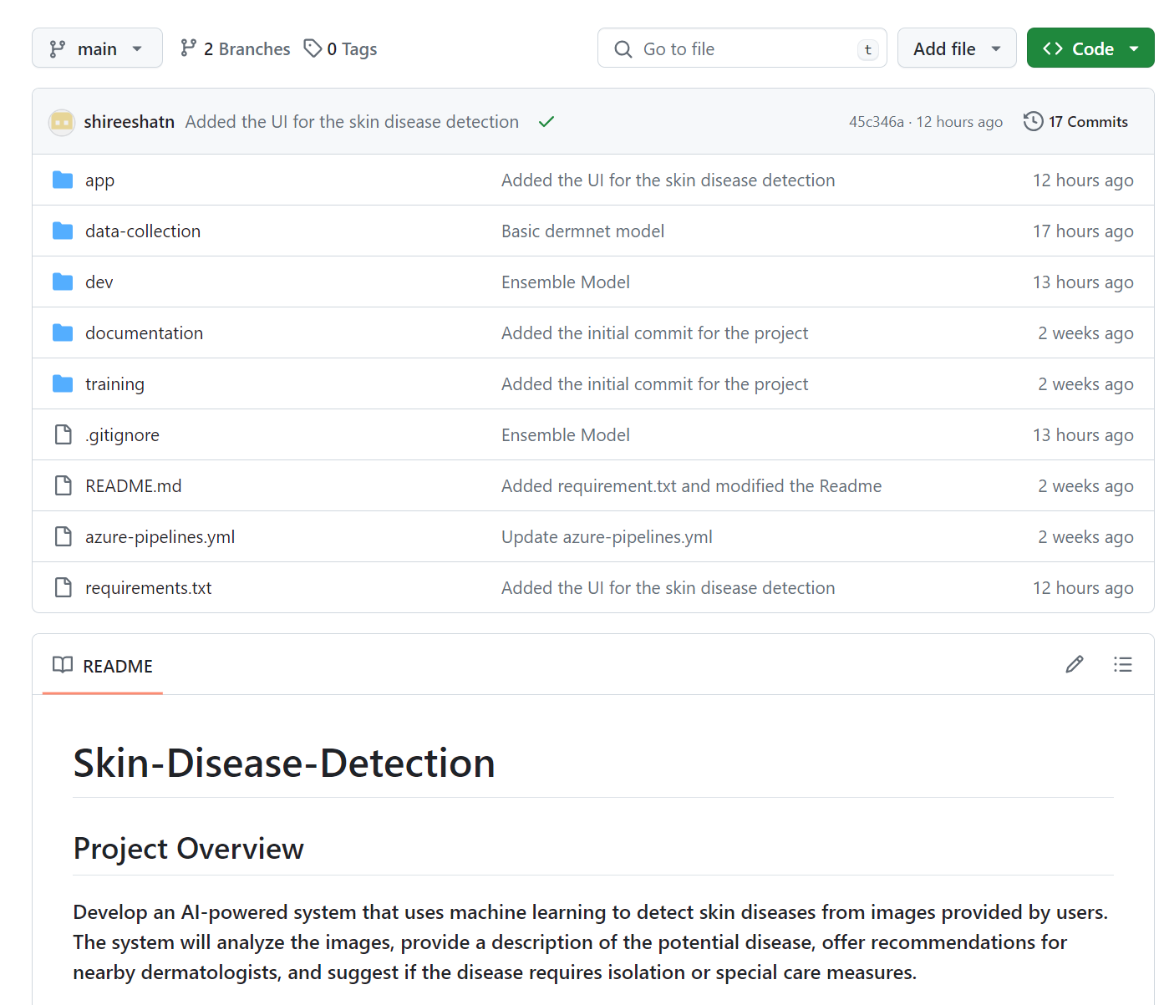
Github
HTTPS://GITHUB.COM/SHIREESHATN/SKIN-DISEASE-DETECTION

